Slide 1
Assignment 2 Model of a cycling app
by
Sasha Stepanov

Slide 2
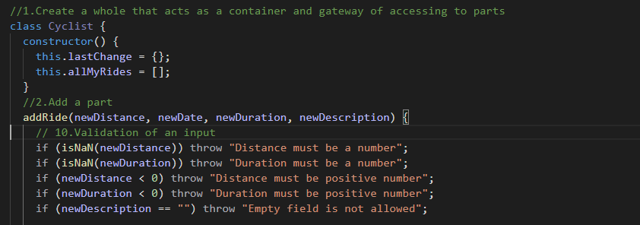


1.Create a whole that acts as a container and gateway of accessing to parts
Class Cyclist is a container for a rides

Slide 3
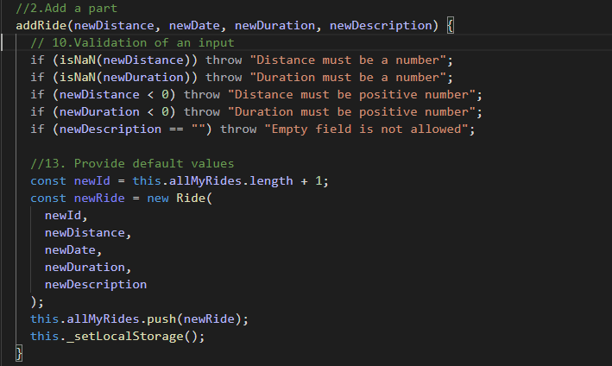

2.Adding a new ride to the cyclist
addRide method adds a new rides to the class Cyclist, saves (pushes) them to the array allMyRides.

Slide 4
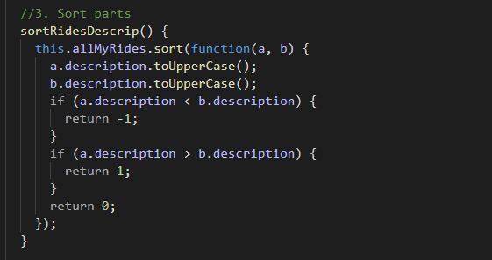
3.Sort parts
This method sorting rides in allMyRides alphabetically by description. Does not create a new array!

Slide 5
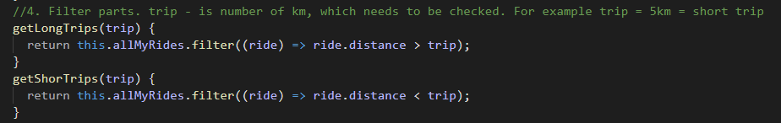
4.Filter parts
Those methods filters rides into short trips and long trips

Slide 6
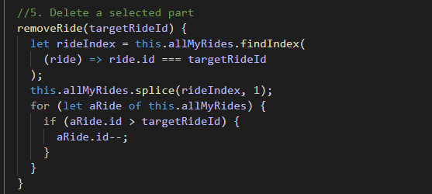
5.Delete selected part
This method deletes a ride by getting ID of this ride and splicing(removing)it from an array. To prevent duplications for loop is

Slide 7

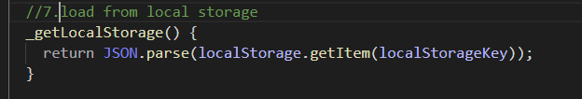
6/7Save and load from local storage
This method converts into string all rides and then saves them to a Local Storage as a file JSON
This method loads all rides from the local storage

Slide 8
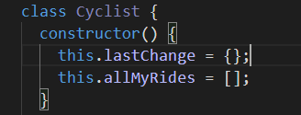
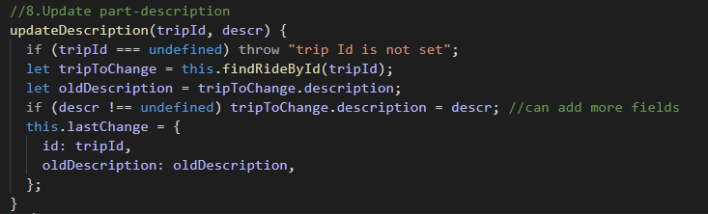



8.Update part
That part of a method helps to keep track of a last update
This method updates/changes a description of a ride and saves it into lastChange. There are two parameters tripId (id of a trip needs to be updated) and descr(description that is going to replace old one)

Slide 9
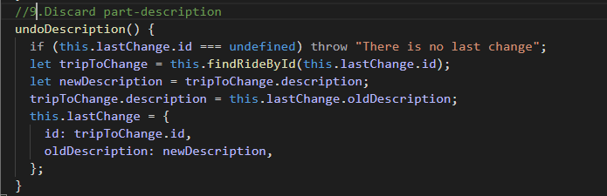
9.Discard Part
This method discard previous( last) change of a description

Slide 10
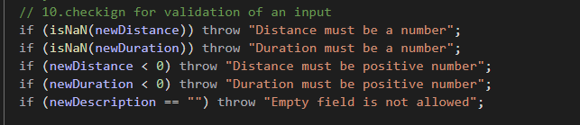
10.Validation of an input
This method validates input and throws an error if an input is negative or not a number, or an empty string for a description

Slide 11
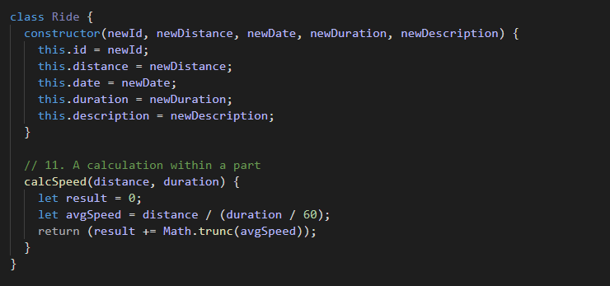
11.Calculation within a part
This method calculates a speed of a ride

Slide 12
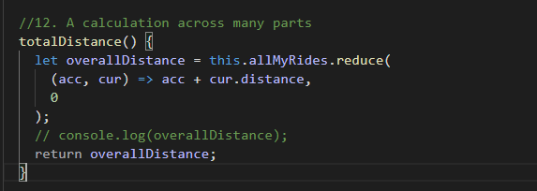
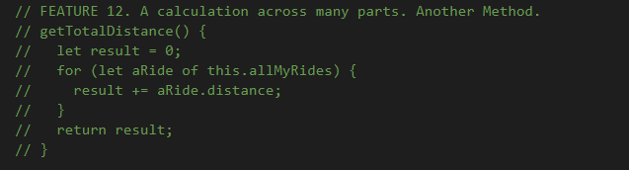
This method is calculating all ride distances combine. Method reduce perfect for this situation

Slide 13
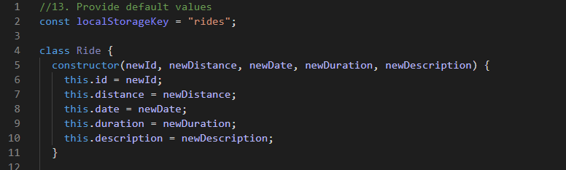
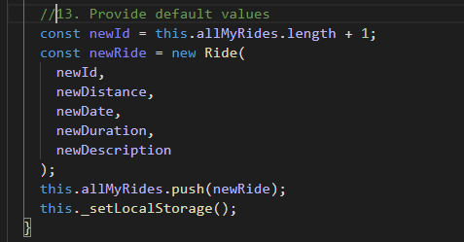


13.Provide default values
Global constant localStorageKey is a default value
assigning a correct ID based on the length of the allMyRides array.

Slide 14

14. Find a part
This method is finding a ride by a giving parameter tripid. Find method is perfect for this situation.

Slide 15
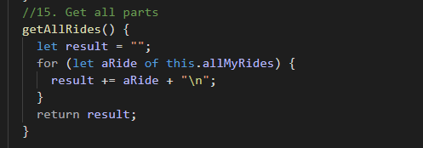
15.Get all parts
This method returns all rides from an array allMyRides. For loop is implemented.

Slide 16
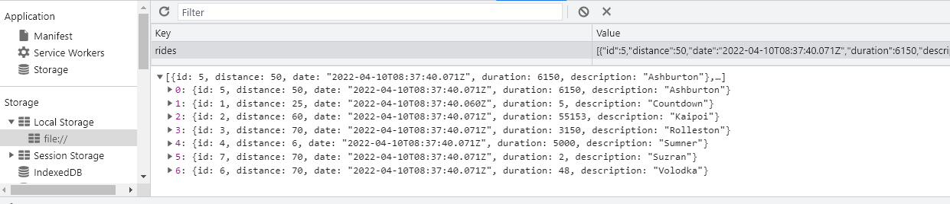
Saving to a local storage

